Slide 1
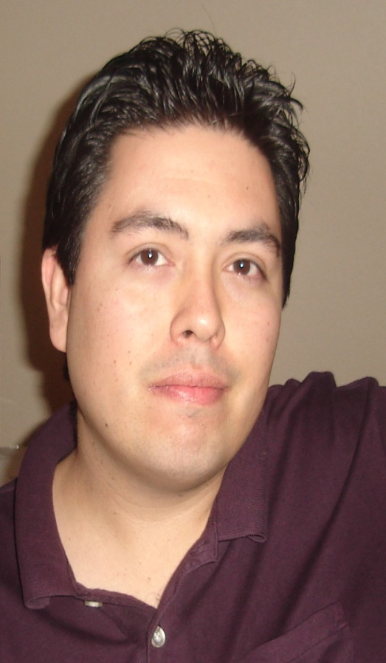
MY LIFE
by
Joey Nieto

Slide 2
About Me
Pursuing a Bachelors in Business Administration-Finance
Employed at the 3rd Judicial District Court
Happily married for 5 years
Proud father of 22 month old daughter
Car enthusiast

Slide 3
VALUES
FAMILY
Enjoy life to the fullest with those who matter most in life
HONEST
Doing the right thing without expecting recognition
GOAL ORIENTED
Taking advantage of every opportunity in life to succeed
ROLE MODEL
Become a Role Model by setting the example

Slide 4
VISION STATEMENT
Live a long productive life to provide my daughter the necessary tools and resources to enable her to excel in life and accomplish her goals

Slide 5
MISSION STATEMENT
To accomplish goals set out in life through self discipline and determination. To endure life’s challenges by eliminating discouragement and overcoming obstacles. To never give up no matter how many times I fail.

Slide 6
5 TO 10 YEAR FROM NOW
Obtain my bachelors degree in December 2011
Obtain a position with NM Administration of the Courts (or)
Obtain a federal position in finance or with the U.S. District Court
Be involved in daughter’s education and extracurricular activities
Retire by the age of 50 (25 years from now)

